Slide 1
Καιρος
Noah Gallo, Nathaniel Kanooi, Tre Carlton, Isaiah Houge, Colby Nelson

Slide 2

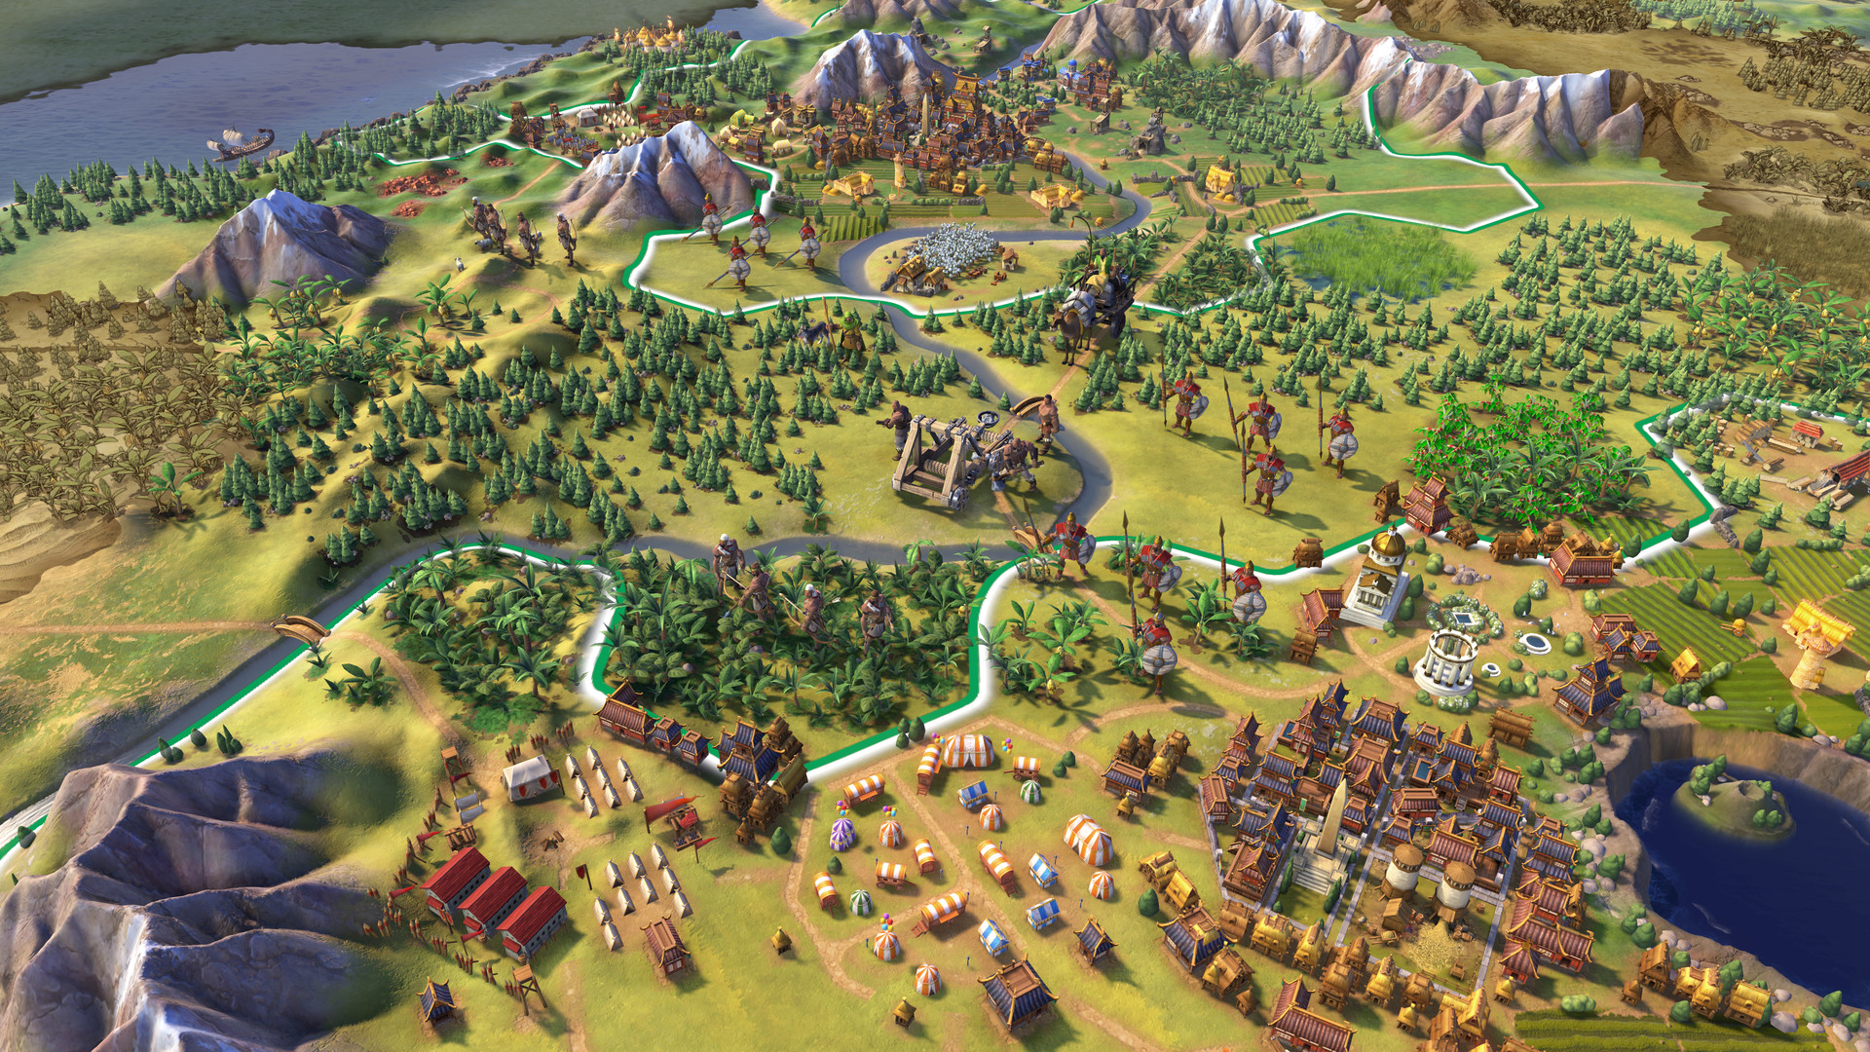
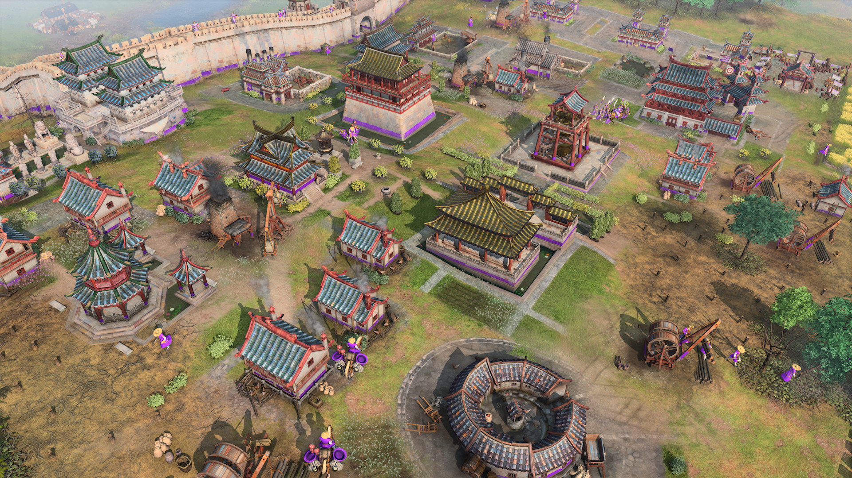
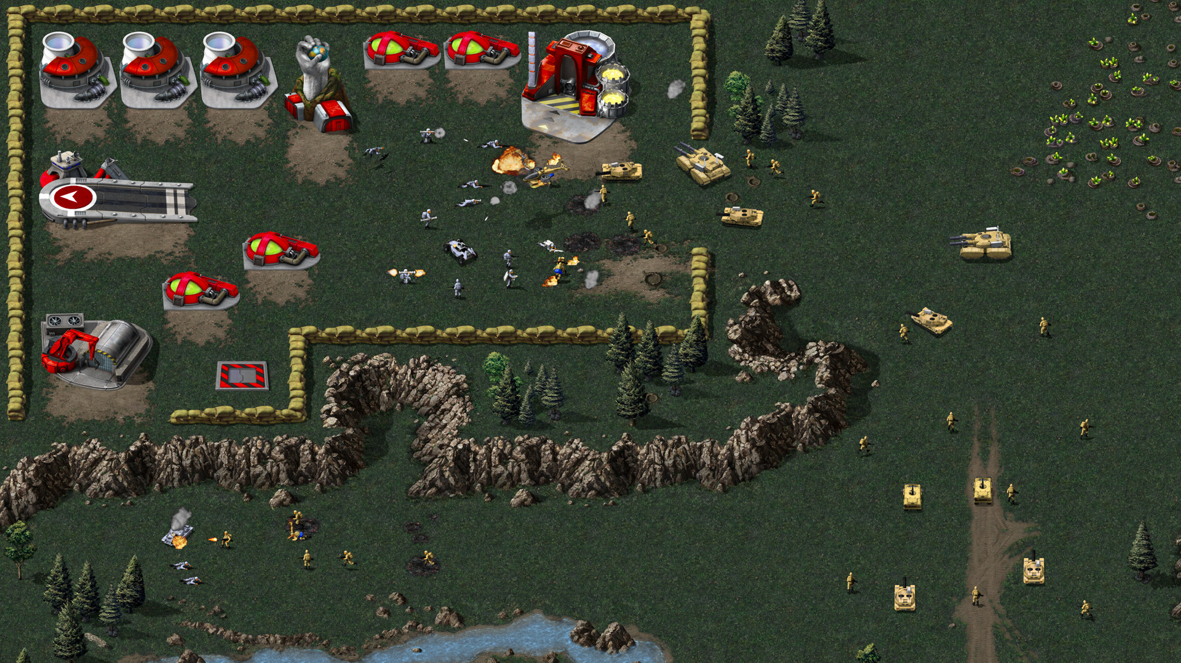
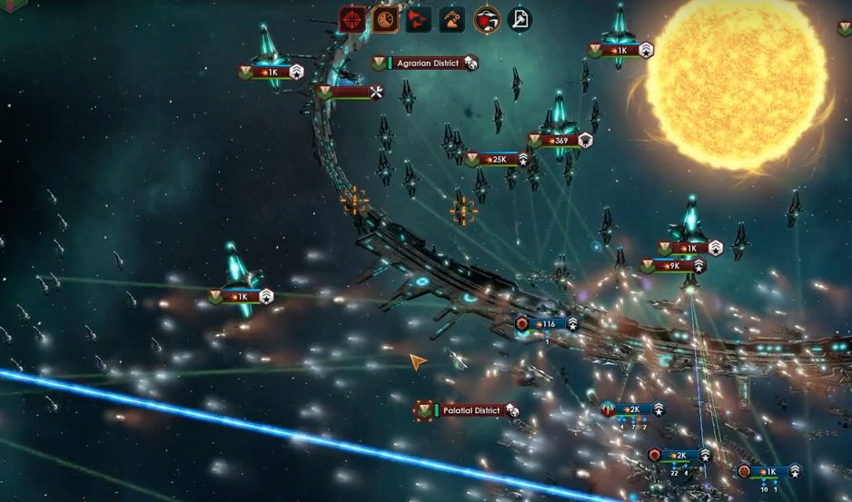
What is Καιρος?
Empire Builders
Real Time Strategy

Slide 3

Audience

Slide 4




Tools

Slide 5

Deployment

Slide 6
Goals
The map will be randomly generated to produce an interesting different experience every time.
The player will be able to place structures and units on the terrain to build up there empires and engage in diplomacy or war with other nations.
Players will have access to multiple different menus that gives them macro control over there empire
Any one will be able to download the game off of gaming platform, Steam

